Slide 1
Wonder Boys & Social Noise
Tyler Parker
Arkansas Tech University

Slide 2
How can analytics help with retention and recruitment of students through social media?

Slide 3
GRM
Notes:
Get
Retain
Maintain

Slide 4
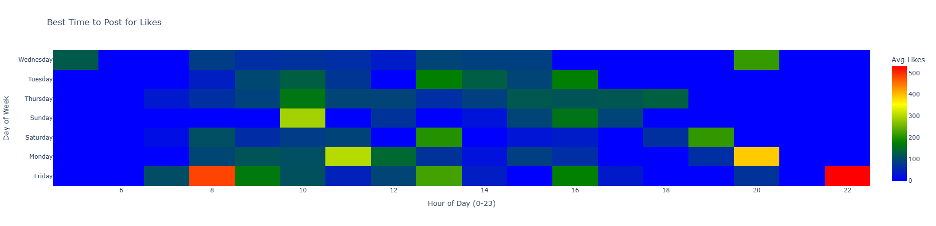

Slide 5
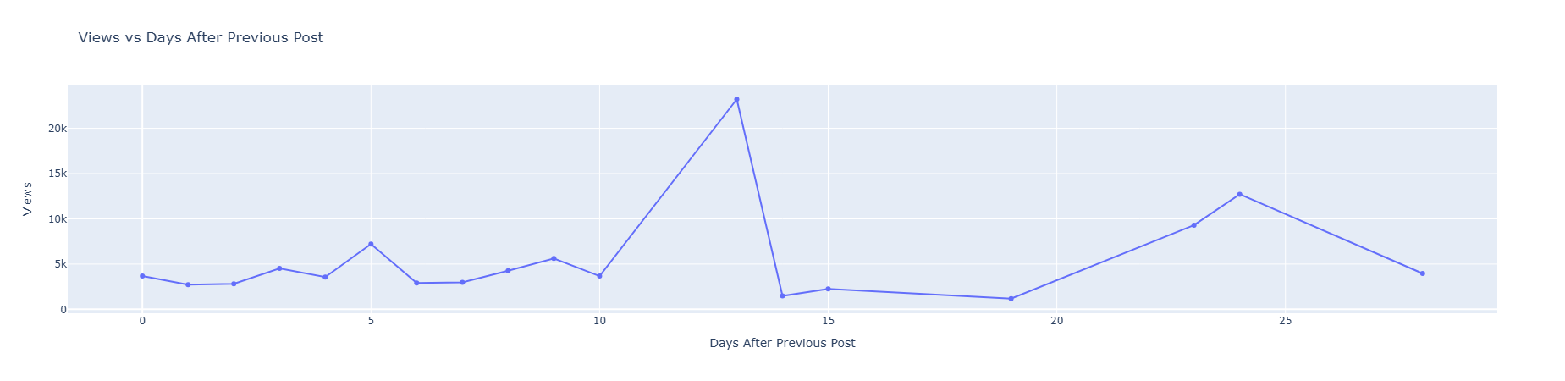

Slide 6
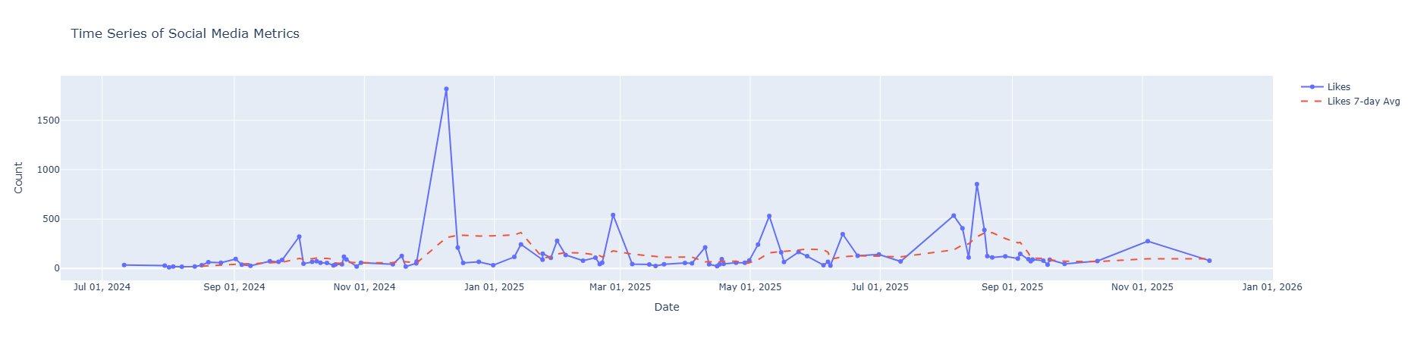

Slide 7
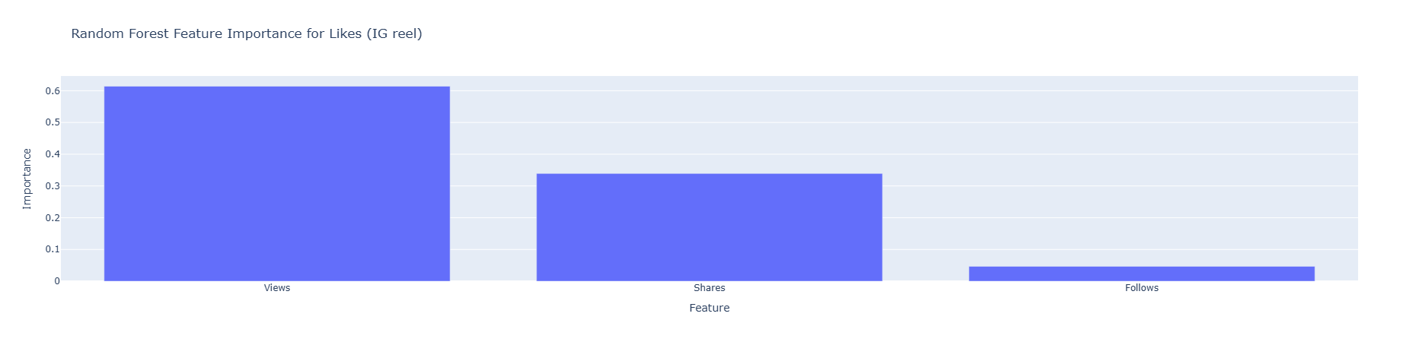
Feature Importance

Slide 8
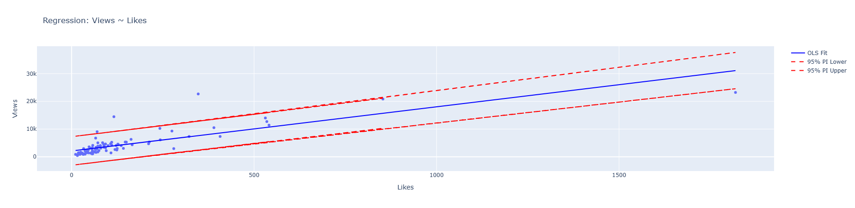
Regression

Slide 9
https://www.instagram.com/reel/DDXohBRv5U5/
https://www.instagram.com/reel/DNYX-B6xKx8/
https://www.instagram.com/reel/DK2Q7I-x5Tq/

Slide 10
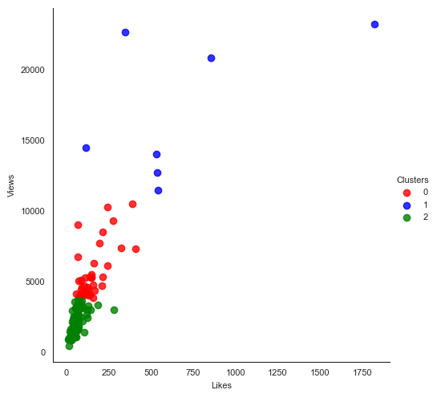
Notes:
Reel
cluster Likes Views
0 124.3125 4492.104167
1 323.666667 11132.11111
2 53.985294 1698.882353
3 1006.333333 22246.33333

Slide 11
Text Analysis
Sentiment -1:1 negative – positive wording
Subjectivity: 0:1 factual – opinionated

Slide 12
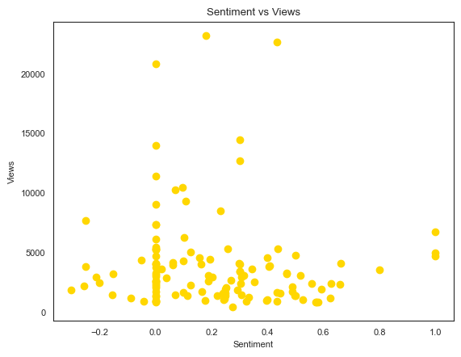

Slide 13
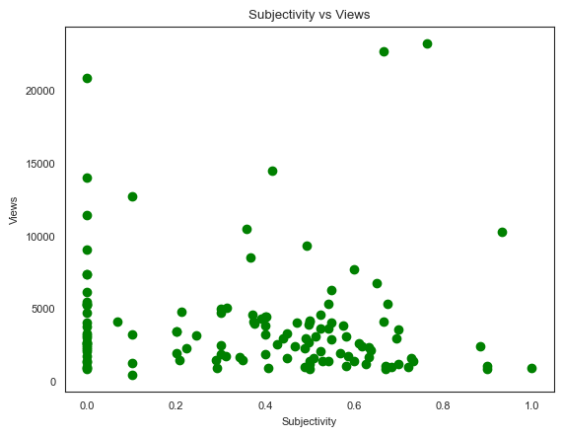

Slide 14
Characters = 301
Words = 43

Slide 15
Findings
Keep descriptions short
Post on Fridays (8 am / 10 pm)
Keep a similar feel to other post that went viral
Push more views

